Slide 1

Cloud Native
Building apps using Cloud Technology

Slide 2
What is Cloud-native ?
Cloud native is the software approach of building, deploying, and managing modern applications in cloud computing environments. Modern companies want to build highly scalable, flexible, and resilient applications that they can update quickly to meet customer demands.

Slide 3
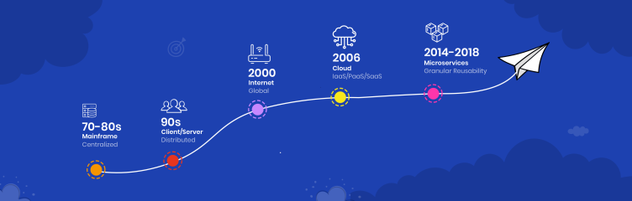
Evolution of Cloud Native

Slide 4
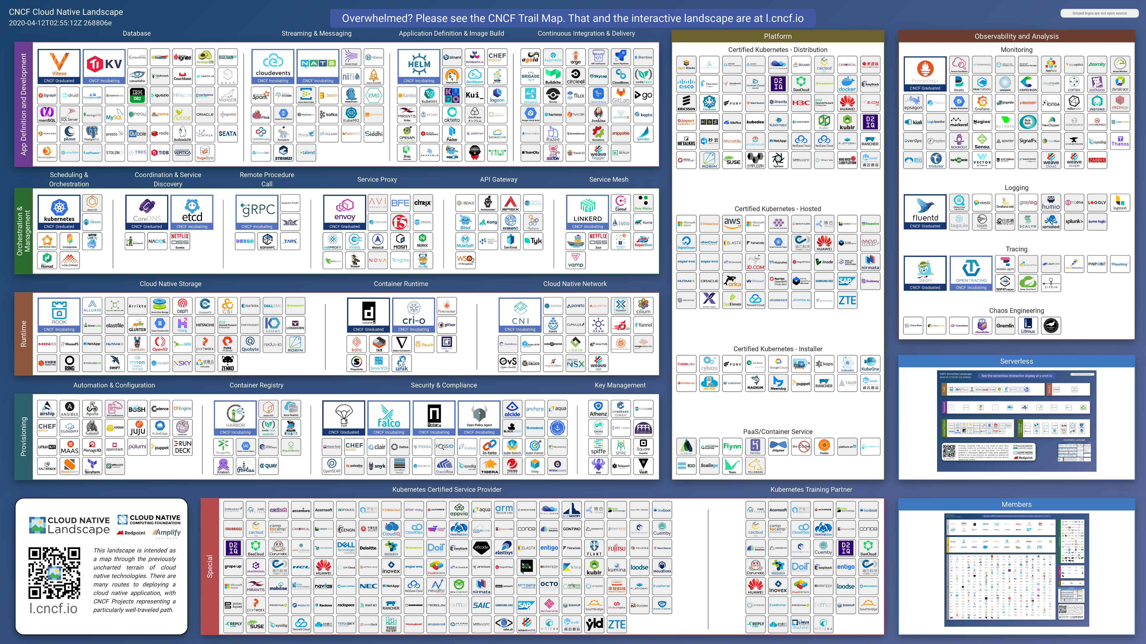

Slide 5
Four Pillars of Cloud Native
What we build ?
Micro services
How we build ?
Conatinerization
How we Deliver ?
Continous Devlivery (CI/CD)
How we manage ?
DevOps

Slide 6
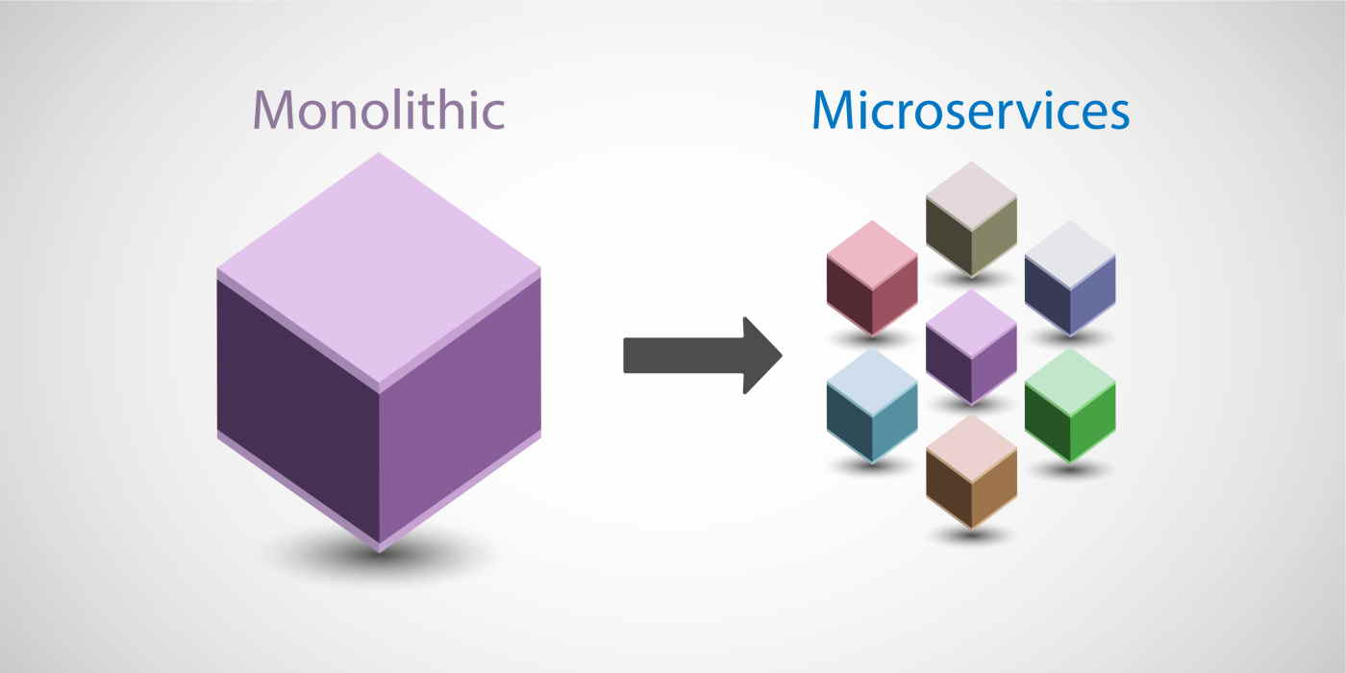

Slide 7
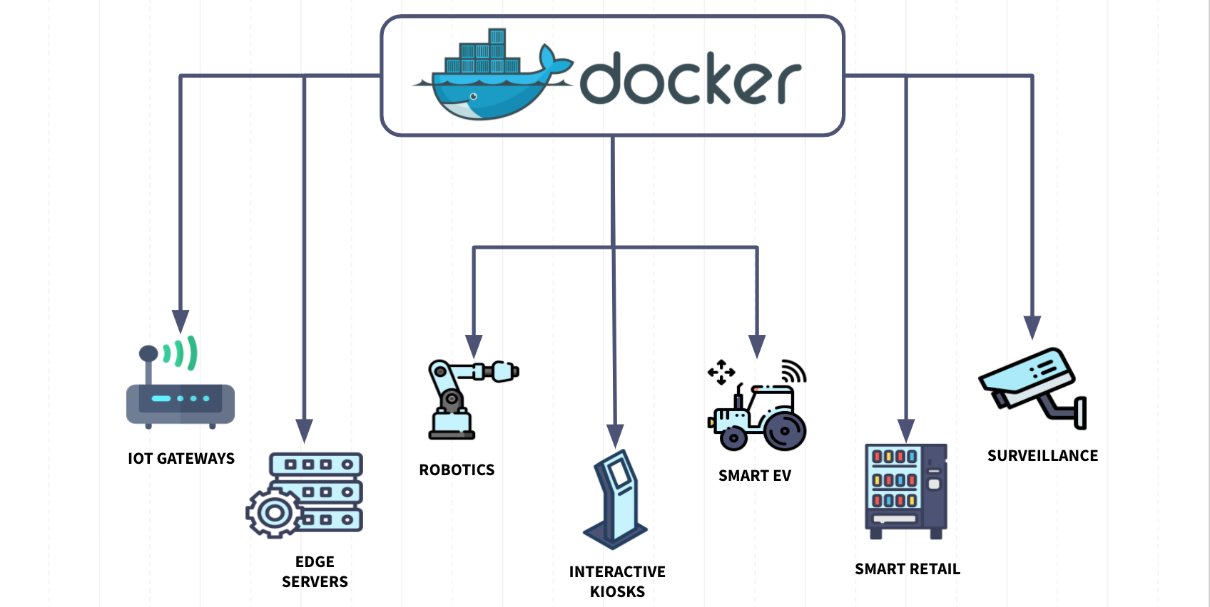

Slide 8
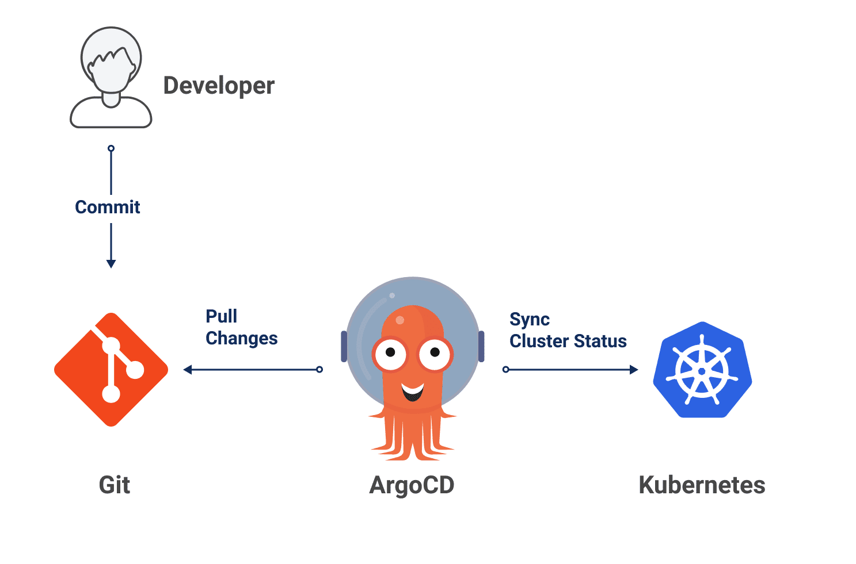

Slide 9
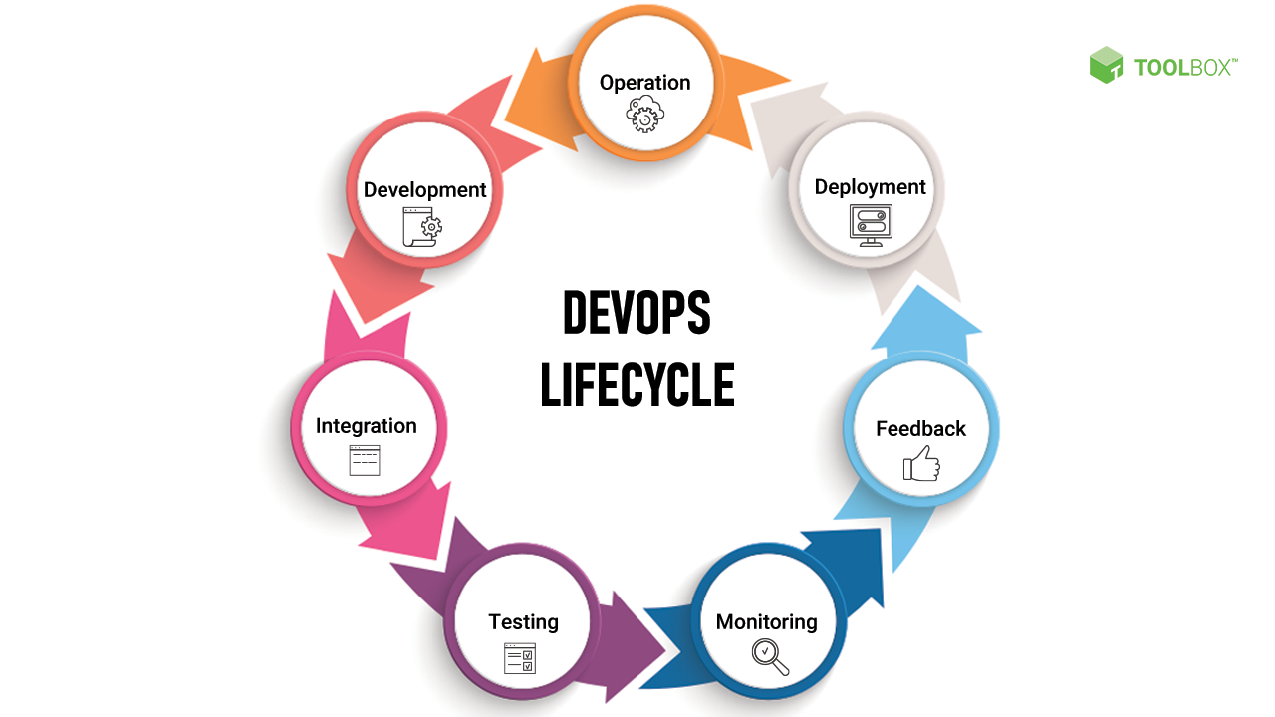

Slide 10
Thank you

